Slide 1
Classes and Objects

Slide 2
Defining Abstraction
Abstraction is the process of extracting common features from specific examples
Abstraction is a process of defining the essential concepts while ignoring the inessential details
Class is an abstraction of all possible objects
Notes:
One of the primary goals of a high level programming language is the simplification of unfriendly, complex, low level computing instructions using a structure that is easier to use, understand organize, maintain and extend.

Slide 3
Everything is an Object
Anything that you can describe can be represented as an object, and that representation can be created, manipulated and destroyed to represent how you use the real object that it models.
Notes:
So what is an object?
In our previous discussion, we said that an object embodies its own unique behavior, and each one models some object in the real world (and is therefore something that exists in time and space). A car or a book are examples of such objects. You can describe a car, repair it, drive it, and/or even sell it. You can buy a book, read a book, and/or even provide a review of the book.
But in the real world, tangible items are not the only kind of objects that are of interest to us during software development. A work assignment, for example, is not something you can touch but you can describe it, discuss it, assign it and/or complete it. Book borrowing is also not tangible but you can describe it, monitor it and/or report it.
Basically, anything that you can describe can be represented as an object, and that representation can be created, manipulated and destroyed to represent how you use the real object that it models.

Slide 4
Defining an Object
An object is a self-contained entity
with attributes and behaviors
information an object must know:
identity – uniqueness
attributes – structure
state – current condition
behavior an object must do:
methods – what it can do
events – what it responds to
Notes:
Each object defines three basic types of information that it must know:
1. An object has to describe the features that will allow its users to distinguish it from other objects. It needs to have an identity. Even if two objects share the same features, each object has a unique identity.
2. An object must be able to describe itself. This type of information is stored in an object’s attributes and which form the object’s structure.
3. An object must be able to describe its current condition, called its state. Object state is sometimes represented by the values of each of its attributes.
For example, a car can be brand new or worn out. Other times, the state is represented by the presence or absence of key relationships with other objects. For example, a book can be reserved or ordered. A reserved book has a relationship with the person who reserved it. An ordered book has a relationship with an order.

Slide 5
Class as Abstraction
A class is an abstraction of its instances. It defines all the attributes and methods that its instances must also have.
Person
name
gender
age
tellGender()
tellAge()
Notes:
Person p1 = new Person( );
P1.name = “ABC”;
P1.gender= “male”;
P1.age= 40;
Person p2 = new Person();

Slide 6
Defining a Class
A Class acts as the template from which an object is created. The class defines the properties of the object and the methods used to control the object's behavior.
A Class specifies the structure of data as well as the methods which manipulate that data. Such data and methods are contained in each instance of the class.
A Class is a model or template that can be instantiated to create objects with a common definition, and therefore common properties, operations and behavior.
A Class provides a template for defining the behavior of a particular type of object. Objects are referred to as “instances” of a class.
Notes:
Class defines the general structure for all possible objects.
Objects are real entities. They have unique values for the data of the class.
Notes:
We provided several definitions just to be comprehensive.
In the real world, you often have many objects of the same kind. For example, your car is just one of the many cars in the world. However, your car has some attributes and methods that are common to other cars. This is because car manufacturers used a blueprint or template in building your car. It would be very inefficient to produce a new blueprint for every individual car that is manufactured. [1]
In the object-oriented approach, this blueprint is called a class. A class is an abstract concept that describes how to build an accurate representation of a specific type of object. It contains variables that define the attributes of an object. It also contains operations that define the associated methods of an object. [2]
Bibliography
[1] http://java.sun.com/docs/books/tutorial/java/concepts/class.html
[2] MDC Application Design School

Slide 7
Basic Terminology
A class defines a kind of objects:
specifies the kinds of attributes (data) an object of the class can have.
provides methods specifying the actions an object of the class can take.
An object is an instance of the class.
Person is a class
Alice and Bob are objects of the Person class.

Slide 8
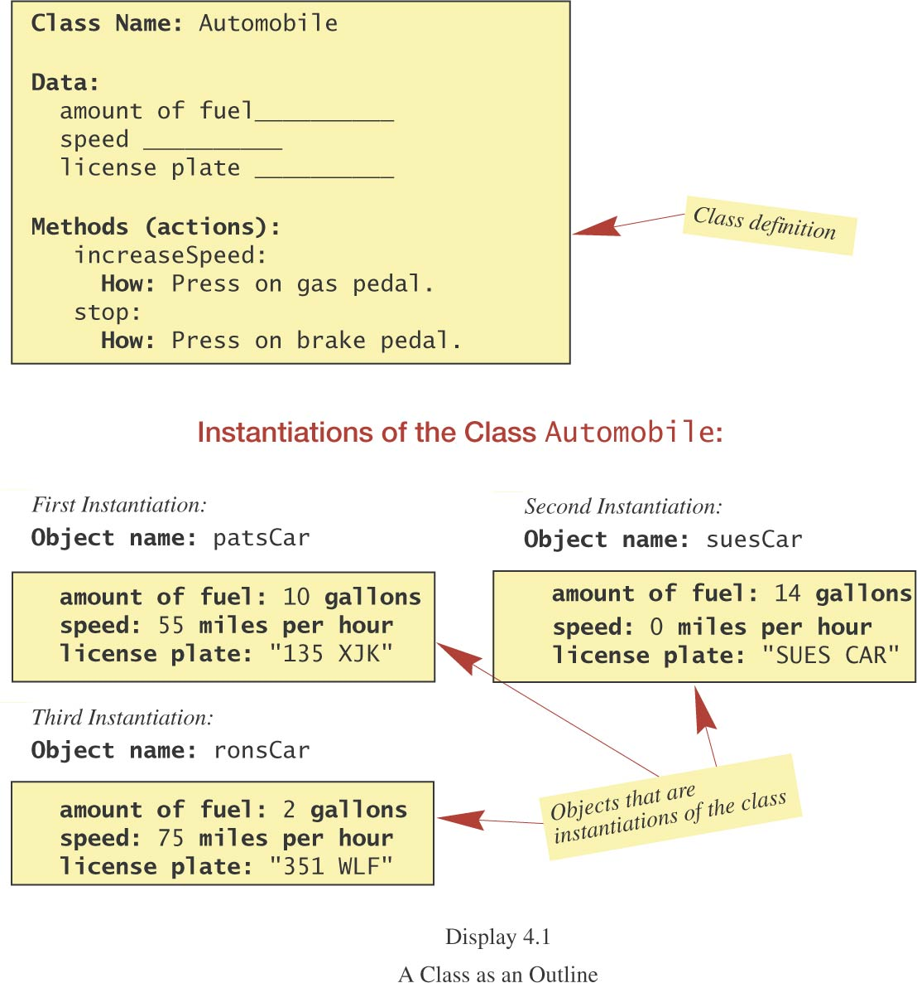
A Class as an Outline

Slide 9
public class Point
{
public int x , y; //data , attributes , properties
//behavior
public void move(int dx, int dy) {
x += dx; y += dy;
}
}
Public class Test
{
Public static void main(String[] arg)
{
Point p1 = new Point(); // (0,0)
P1.x=10;
P1.y=20;
Point p2 = new Point(); //0,0
P2.move(50,60);
}
}
Notes:
Class is created only once.
Infinite number of objects can be derived from it.

Slide 10
------------ Person.java ------ defining Person ---------------------
public class Person
{
private String _name;
private String _iceCream;
public void setName(String newName)
{
_name = newName; // this. is optional
}
public void setIceCream(String newIceCream) { … }
public void print()
{
System.out.println(_name + “ likes “ + _IceCream); // this. optional
}
}
------------ PersonTest.java ----- using Person ------------------
public class PersonTest
{
public static void main(String[] args)
{
Person joe = new Person();
joe.setName(“Joseph”);
joe.setIceCream(“Rocky Road”);
Person mary = new Person();
mary.setName(“Mary”);
mary.setIceCream(“Chocolate Fudge”);
mary.print();
}
}

Slide 11
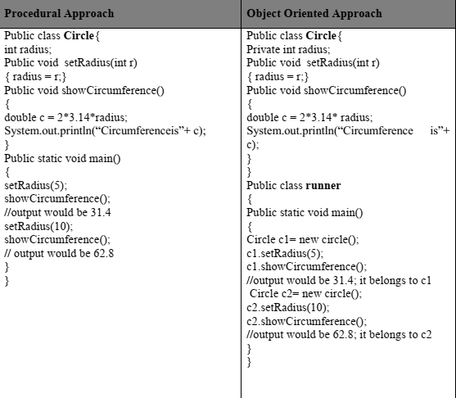
Difference between Procedural and Object Oriented

Slide 12
Creating Classes (UML Notations)
Circle
Rectangle
Time
Date
Distance
Car
Book

Slide 13
Declaring methods inside classes
You must analyse
Function has to operate on which data member ?
Working requires anything other than the data of the class???
Take that as argument to the function

Slide 14
END

